Slide 1

INNOVISTA 2026
Problem Statement Track — Software & Web Applications.
Problem Statement Title — AdaptEd AI - Personalized Learning Assistant.
Theme — Smart Education/ EdTech.
PS Category — Software
Team Name —SkillMatix.
Team Members –
          Rutuja Deshmukh – MET Bhujbal Knowledge City, Institute of Engineering – AIDS - SY
          Rajshree Patil - MET Bhujbal Knowledge City, Institute of Engineering – AIDS - SY
          Aaryan Vispute – KKWIEER – CE - SY

Slide 2
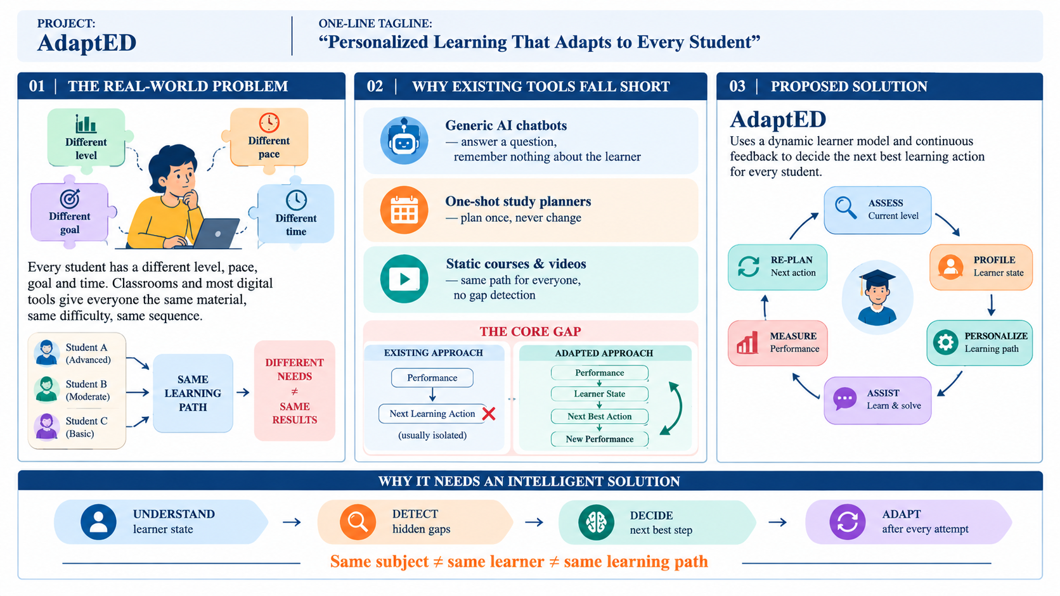
IDEA TITLE

Slide 3
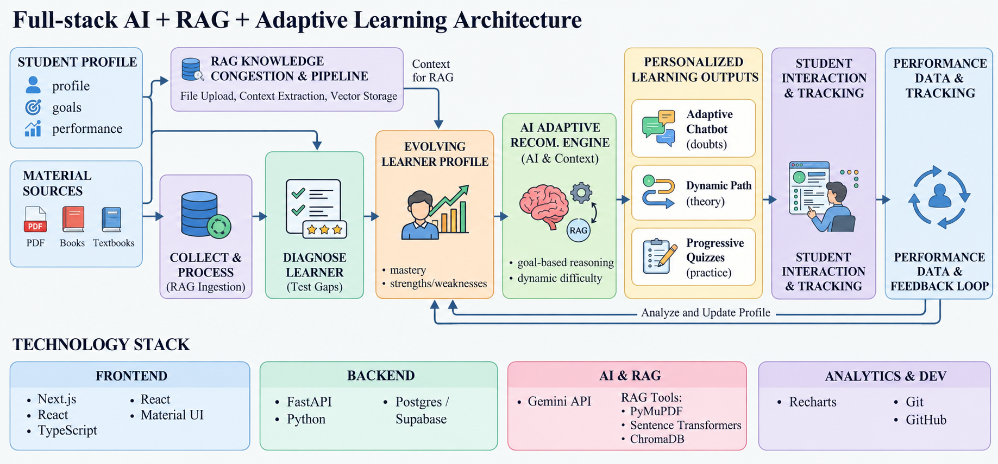
TECHNICAL APPROACH

Slide 4
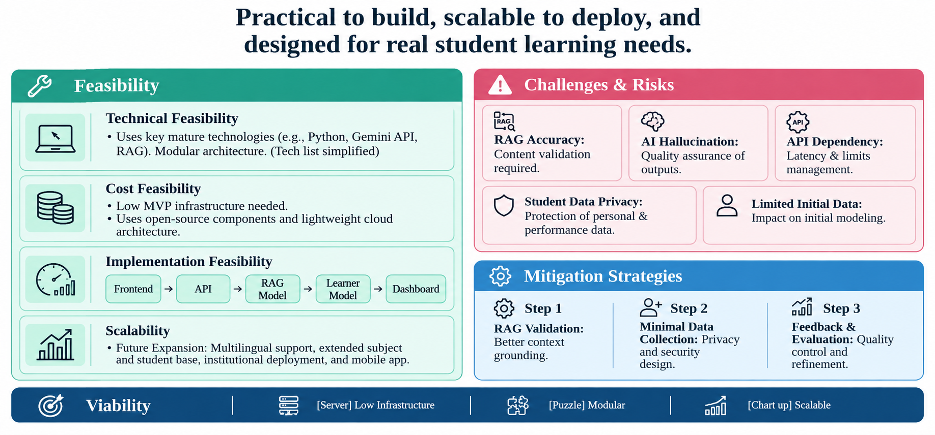
FEASIBILITY AND VIABILITY

Slide 5
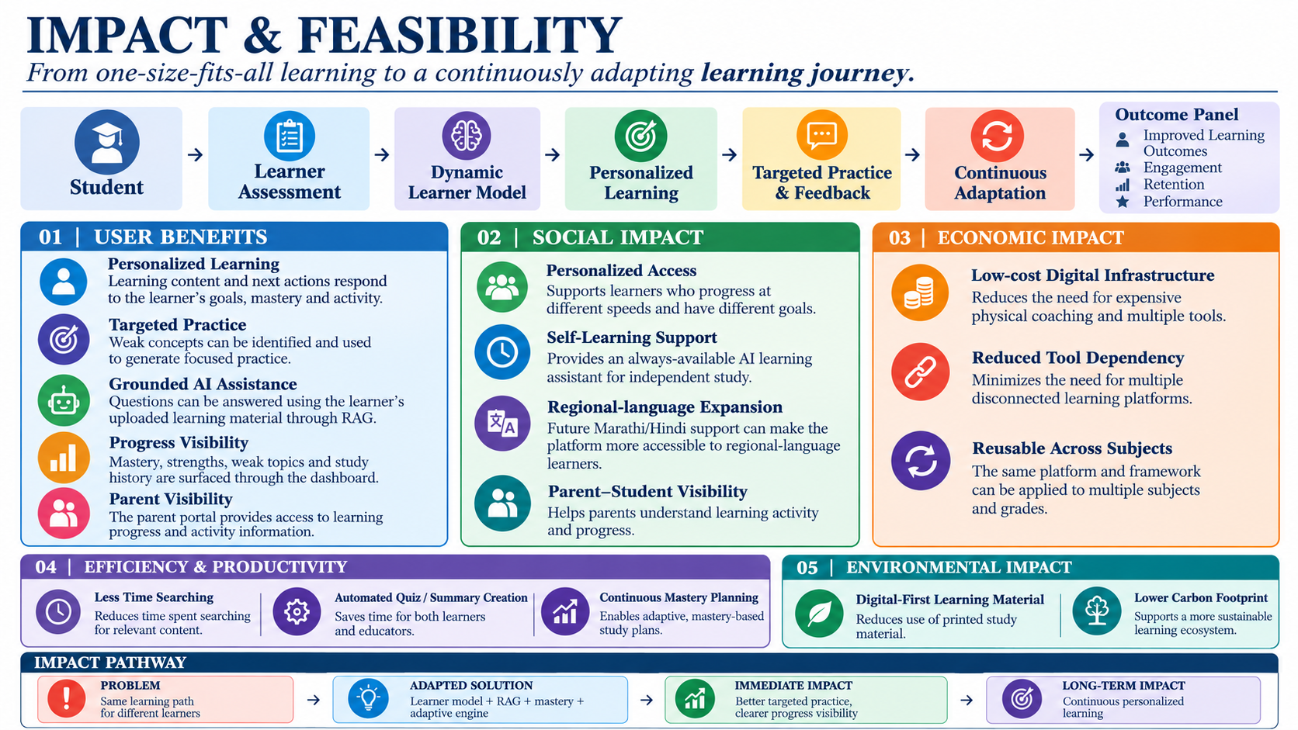
IMPACT AND BENEFITS

Slide 6
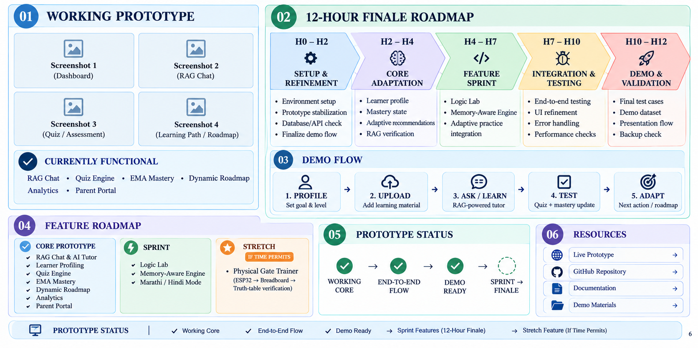
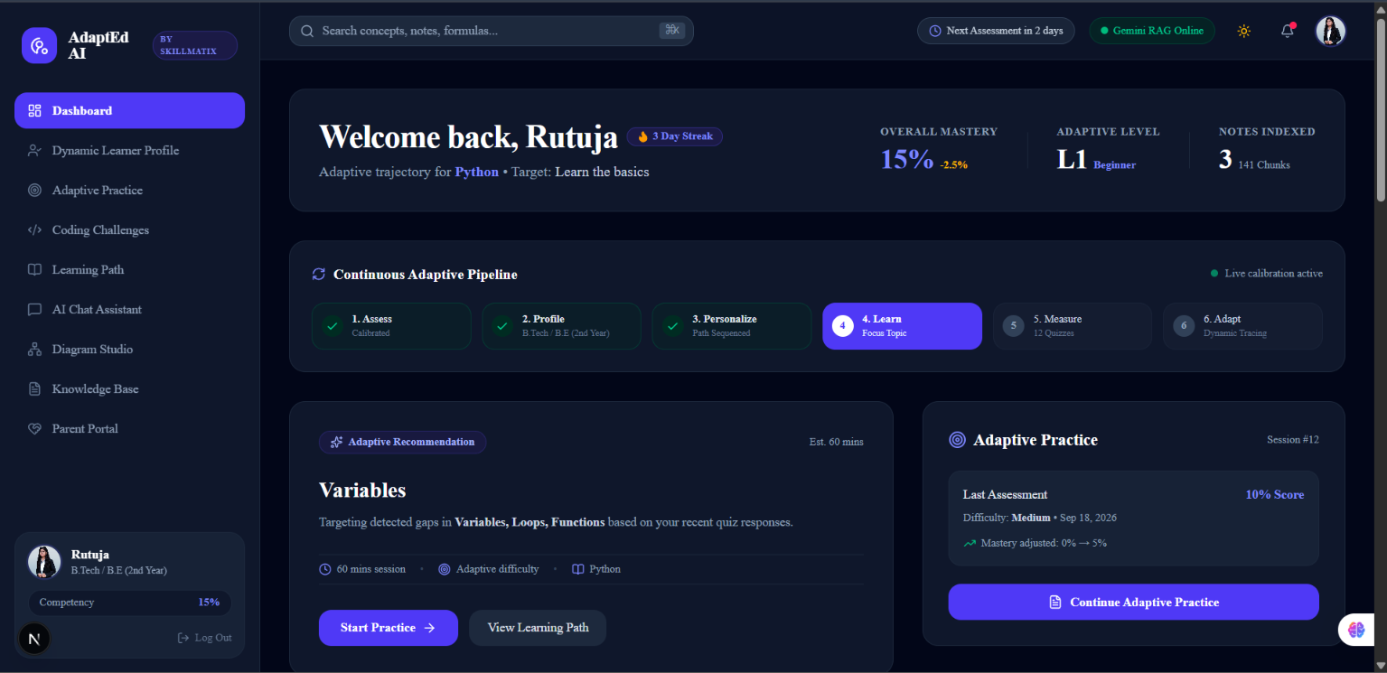
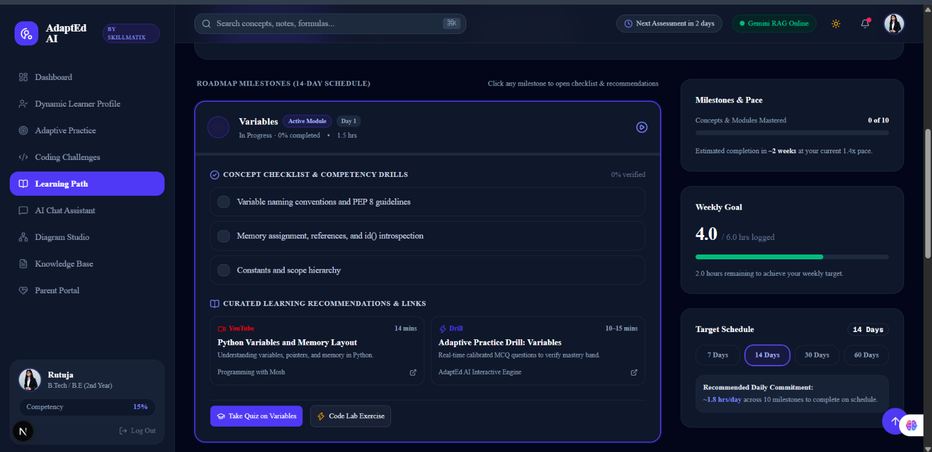
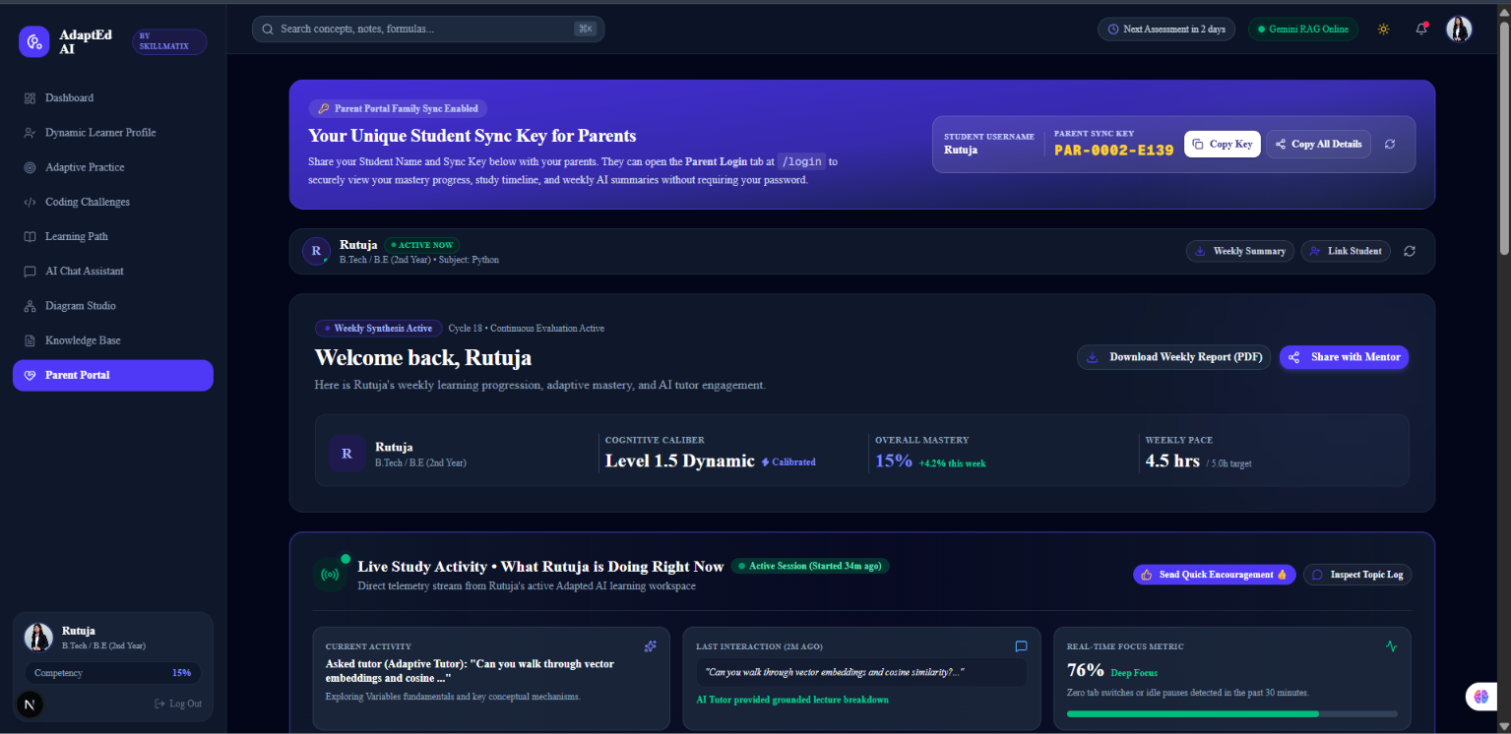
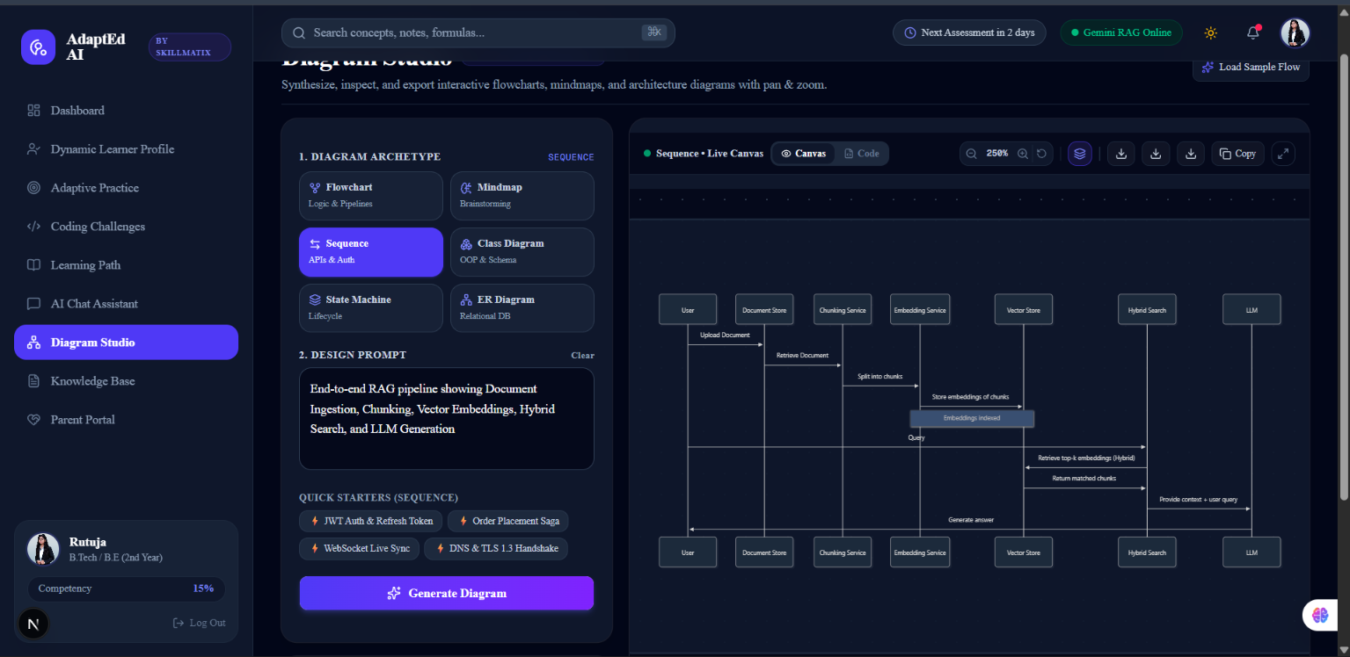
RESEARCH AND REFERENCES

